Slide 1



Platform Engineering :
Backstage & Crossplane
Chidambaram K
Senior Engineer, Presidio
Chandra Mohan S
Associate Engineer, Presidio

Slide 2
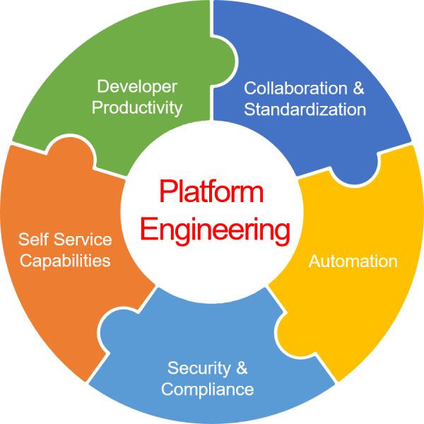
Agenda
Understanding Roles
What is Platform Engineering
Backstage & its Terminology
Crossplane & its Terminology
Demo
Tools Landscape

Slide 3
Understanding Roles
DevOps
DevOps focuses on breaking down silos between development and operations teams, fostering collaboration, and automating workflows for faster software delivery.
SRE
SRE builds upon DevOps principles, emphasizing reliability, incident management, and service level agreements (SLAs).
Platform
Platform engineers create and maintain internal developer platforms (IDPs) that empower developers with self-service tools and resources.
DevOps
Platform

Slide 4
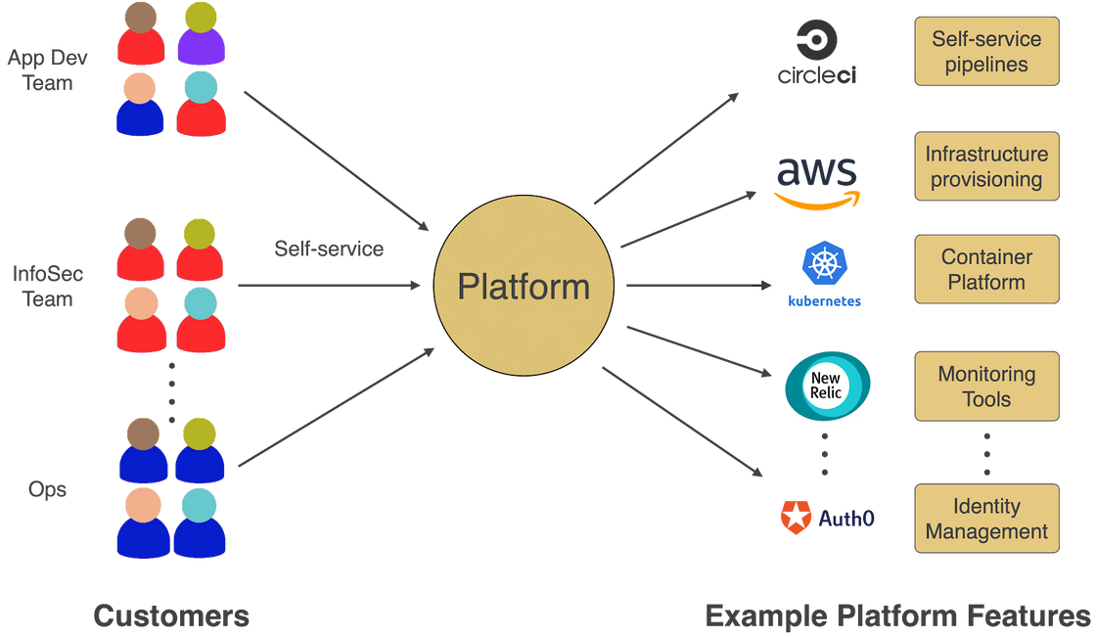
What is Platform Engineering
DevOps
Platform
discipline of designing and building toolchains and workflows that enable self-service capabilities for software engineering organizations in the cloud-native era.

Slide 5
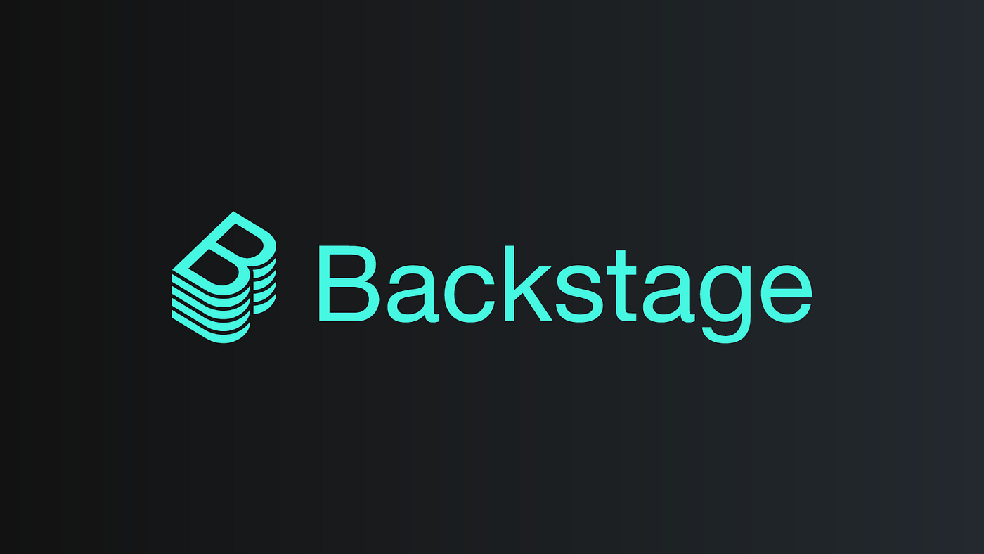
Backstage is an open source framework for building developer portals. Powered by a centralized software catalog.
At its core, It’s a platform for organizing infrastructure, tools, and documentation in a single interface, giving developers full visibility into their environment. It allows teams to focus on building features instead of getting bogged down by infrastructure complexity.
Developer portal by Spotify.

Slide 6


Problems
Fragmented Tooling Landscape
Lack of Service Ownership and Visibility
Difficulty Tracking Operational Metrics
Teams often use diverse tools (CI/CD, monitoring, logging, etc.).
Lack of integration between tools leads to inefficiency.
Developers waste time switching between tools and manually managing services.
Developers often have little insight into the lifecycle or status of their services.
Identifying service ownership, dependencies, or documentation is difficult.
Monitoring and managing service health often involves using multiple systems.
Developers struggle to track key metrics and operational health across the board.

Slide 7
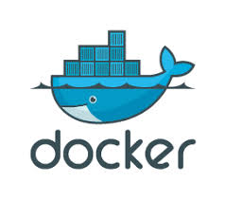
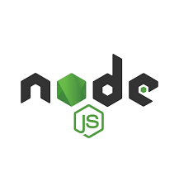


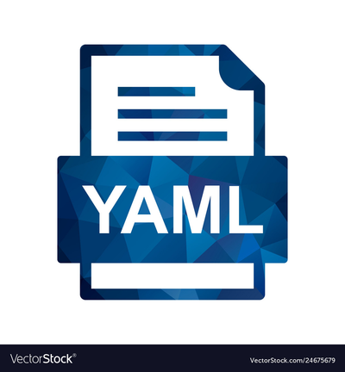

Foundations for Functionality

Slide 8
Core Components
App
Plugins
The app is an instance of a Backstage app that is deployed and tweaked.
Additional functionality to make your Backstage app useful for your company.
Backstage Software Catalog
Entities
Scaffolder
The central repository in Backstage where all software components and their metadata are stored and managed.
Items within the Catalog that represent software components, such as services, libraries, or data pipelines.
A Backstage plugin that helps generate new projects or components using predefined templates and configuration.
Backstage software templates
Backstage TechDocs
It is used for quickly spinning up new projects and standardizing your tooling with your organization’s best practices
It is used for making it easy to create, maintain, find, and use technical documentation, using a "docs like code" approach

Slide 9
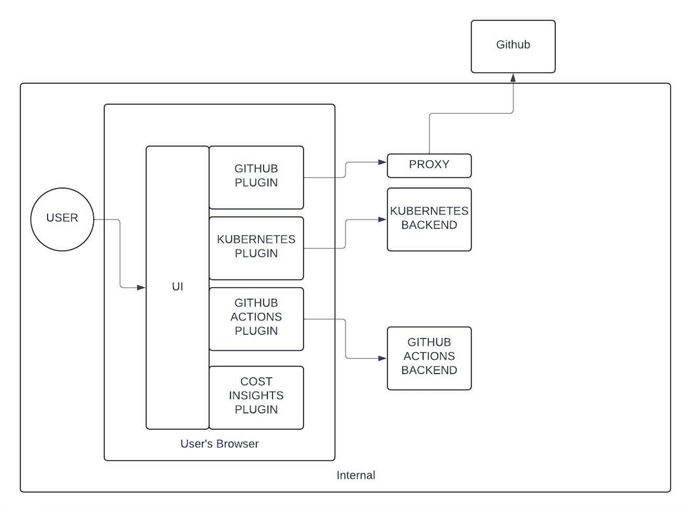
Architecture
There are 3 main components in this architecture:
The core Backstage UI
The UI plugins and their backing services
Databases
The Plugins can take three forms:
Standalone Plugins
Service backend
Third-party backend

Slide 10

It helps maintain standards and best practices across the organization.
01
Provides a central place to manage all projects and documentation
02
Backstage Benefits
03
Fast and simple to build software components in a standardized way.
04
It enables extensibility and scalability
It’s a single, consistent experience that ties all your infrastructure tooling, resources, standards, owners, contributors, and administrators together in one place.
05

Slide 11

Crossplane
universal control plane

Slide 12
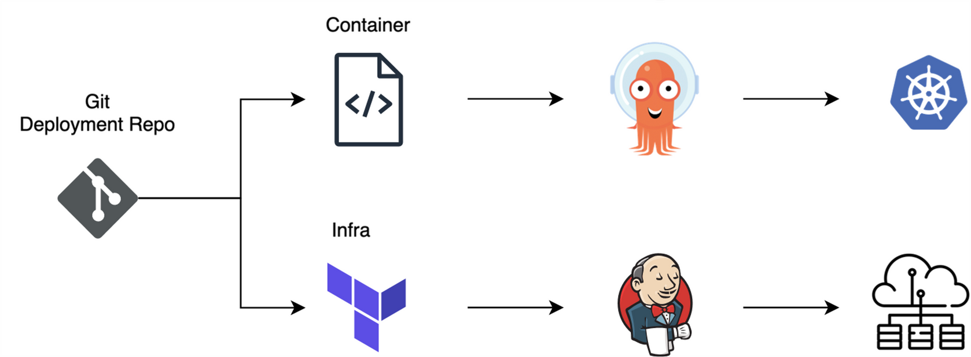
What Problem It Solves ?
Manage both applications and infrastructure using Kubernetes-native APIs.​
The traditional approach involves two sets of processes for the deployment illustrated below
Traditional Pipeline

Slide 13
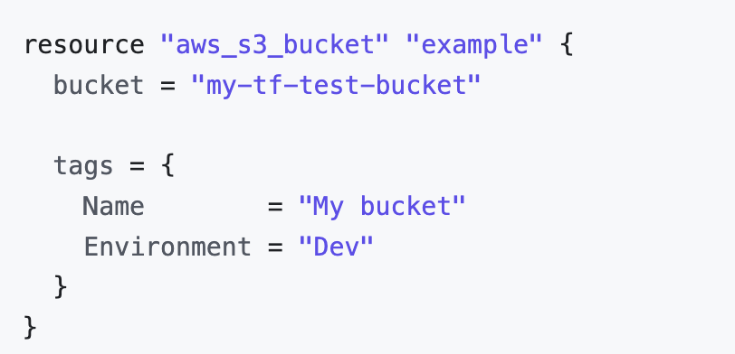
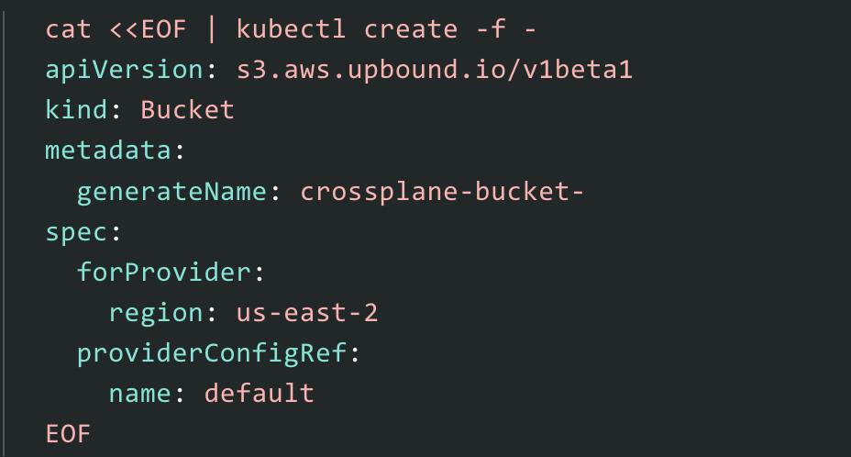
Contd. Managed Resources​

Slide 14
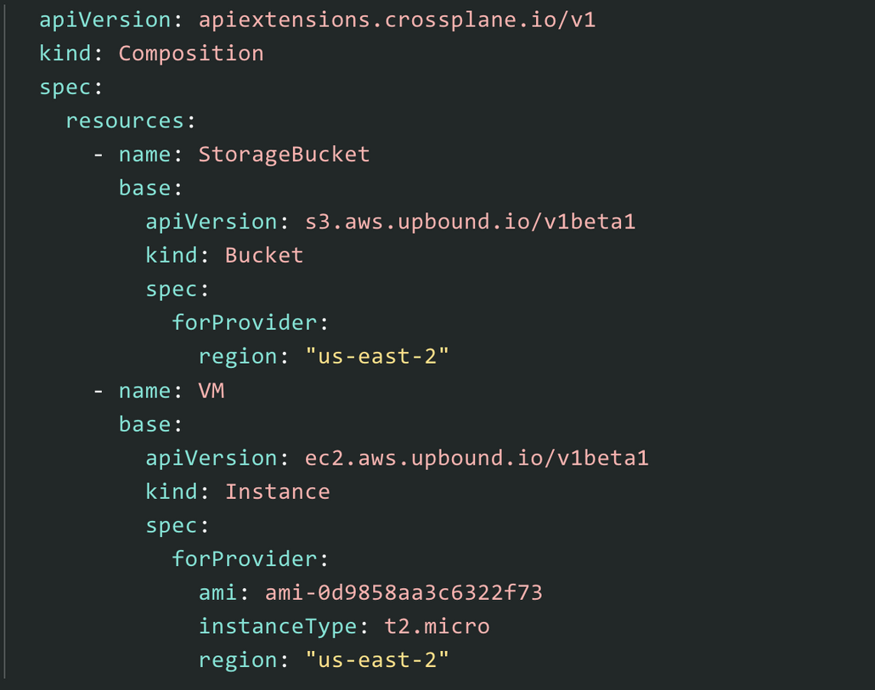
Contd. Compositions​
It's like Terraform Module Code​
​
​
describe more complex deployments, ​
combining multiple managed resources ​
and any resource customizations​

Slide 15
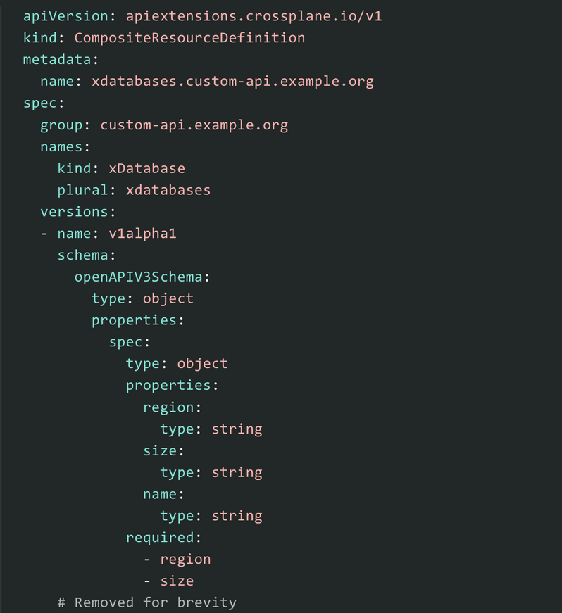
Contd. Composite Resource Definitions ( XRD )​
Similar to Terraform Modules Input & Output Definition ​
use an OpenAPIv3 schema to further extend​
Kubernetes with custom API endpoints, revisions and more​

Slide 16
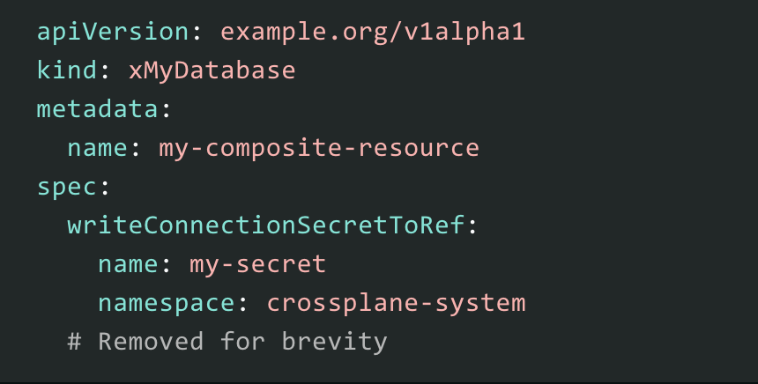
Contd. Composite Resource ( XR ) & Claims ( XRC )​
Like Calling a Module​
XRs use the Composition template to ​
create new managed resources.​
​
Claims ( XRC ) similar to XR, but with ​
namespace scoped​

Slide 17

Demo

Slide 18
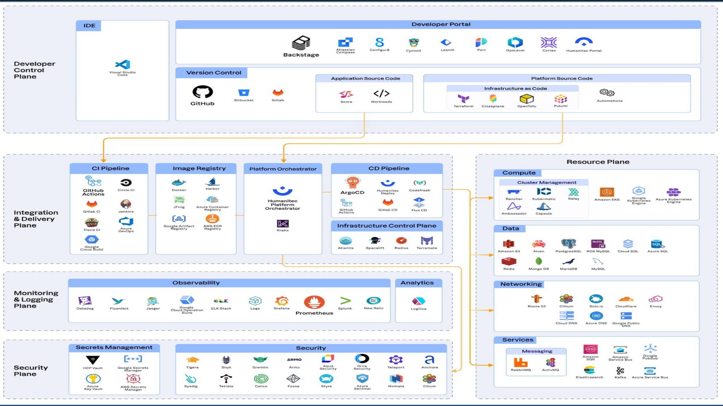
Platform Tooling Landscape

Slide 19
Thank you

